Slide 1
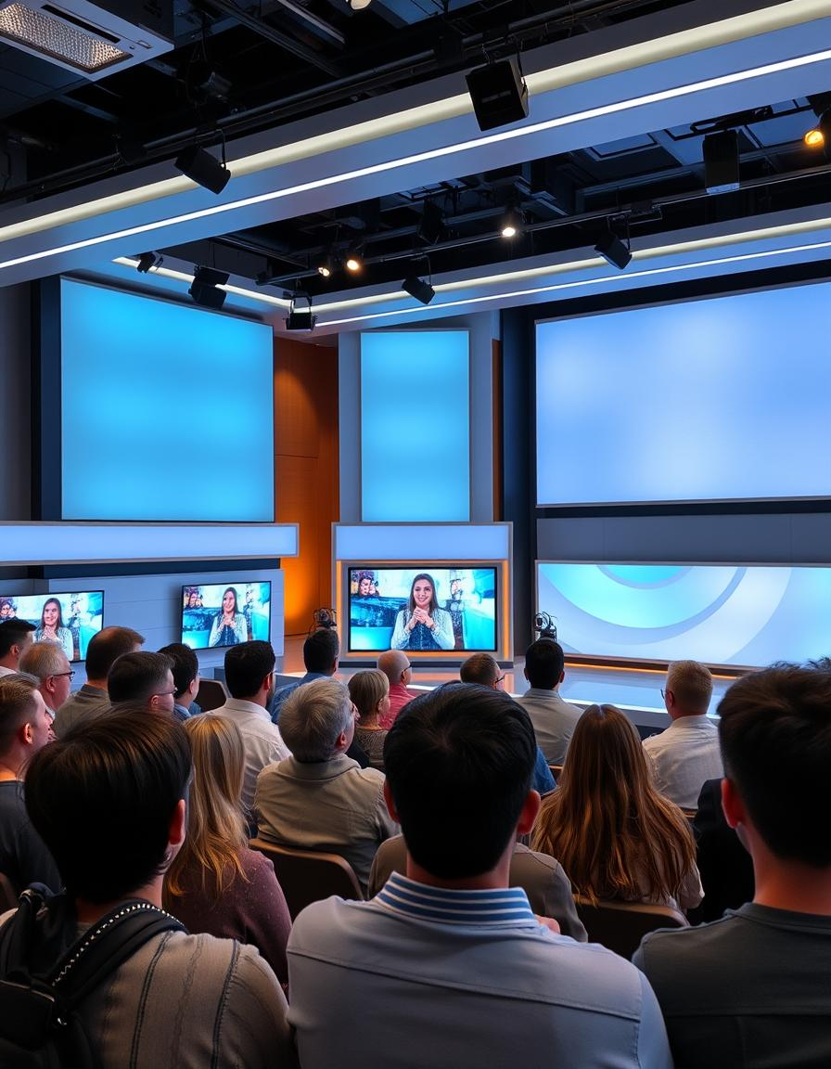
BRIGHT TV PRESENTATION
Ici commence votre présentation

Slide 2
TABLE OF CONTENT
01
02
03
04
Introduction
Data analytics and tools
Content to recommend to increase consumption
Factors influencing consumption
05
Innitiative to grow viewership

Slide 3
Introduction
This presentation explores detailed SQL queries used to analyze viewership data and user profiles.
We cover data cleaning, joining tables, and extracting insights on demographics, viewing habits, and channel popularity. The goal is to understand audience behavior through various dimensions such as age, gender, race, province, and time segments.

Slide 4
Data analysis tolls
We used the following ;
Dataset (user information
Userprofile (converted to csv)
Viewership
Miro
Snowflake

Slide 5
* This indicates that number of view by gender its black population

Slide 6

Number of views per Age Group

Slide 7
Percentage according to the Month per viewership
Mars

